Slide 1

Mentoring graduate students in the teaching and learning of Linear-Algebra
Dr. María Trigueros
Instituto Tecnológico Autónomo de México (ITAM)

Slide 2
Mentoring two different types of graduate students
Students who are enrolled in a mathematics related graduate program
Less interest in teaching mathematics
They have to teach during their graduate program
Thy will be teachers as part of a university faculty
Students who are enrolled in a mathematics education program
Interest in teaching
Less interested in advanced mathematics courses
Linear Algebra as part of the courses students need to work
Formative course
Many application
Topics included in high school courses

Slide 3
A rich mentoring approach
A seminar on linear algebra learning and the role of innovative teaching approaches
Analysis of linear algebra problems in terms of concepts involved and previous knowledge needed, through APOS theory
Collaborative work on modeling problems and discussion of different approaches involved in their solution and possible difficulties for students
Analysis of activities designed with the theory to be used in the classroom using the theory
Analysis of undergraduate students’ work when introduced to the same modeling problem or related mathematical problems
Reading mathematics education literature and other theoretical approaches
Through work on these different tasks students discover the many subtleties involved in a deep understanding of linear algebra concepts

Slide 4
APOS theory
Based on Piaget’s work – adapted to mathematics learning and teaching (Dubinsky, RUMEC)
Actions- Processes- Objects Schemas
A theoretical approach closely linked to a teaching methodology the ACE cycle
Didactic cyclic approach: From concrete open experiences to opportunities to discuss on activities developed on APOS theory oriented to fostering abstraction and formal reasoning, whole class discussion on the previous work
Good results

Slide 5
The role of the modeling approach
Graduate students live the experience of working with a modeling situation and working in teams
They may feel lost since the “application” of their linear algebra knowledge is not apparent
Gradually strategies emerge, the teacher’s role is guiding and helping students.
Through whole class discussion questions are posed and discussed, decisions are taken
The teacher decides when to introduce activities to promote the construction of linear algebra concepts that may help in working with the problem
Graduate students and mentor discuss possible strategies to guide students and to listen to them and take decisions for example of introduction of APOS based activities to help students construct new concepts
A cycling approach

Slide 6
Modeling example
Three important politicians will have a meeting to talk about a secret topic. You are spies and want to know what they talk about; so you install some microphones to record the sound in the room where they will meet. After they leave the room, you have four recordings and a map of the room indicating where the politicians were seated. What can we do to know the place where each of the politicians was seated?
Construction of the inverse of a matrix transformation
Discussion in teams
Questions arising in teams and in whole class discussion Why do you consider that the form of the room is important? And the type of voice?
Emergence of model: Consideration of the distance between each source sj and the observation point as a very important parameter and explanation of distance depending on the location of each source (politician), with respect to the observation location (microphone). the resulting map as a microphones’ configuration

Slide 7
Students modeled the observation x_{i}, as a mixture in terms of a linear combination of the sources where each coefficient a_{ij} could be considered as a function of the distance, for a given configuration, that is x_{i} = a_{i1}s₁ +a_{i2}s₂ +...+ a_{ij}s_{m},
Sources and observations considered as vectors
Work was done with different configurations and different numbers of sources partly in class and partly as exercises
General model of m sources and n observations. The functional model was transformed into a matrix transformation model
Need to find the sources, so students worked on defining and finding the inverse transformation and the inverse matrix to solve the problem of separating the voices of the politicians
Introduction of activities based on APOS theory to guide the construction of these concepts

Slide 8
Importance of task design and analysis
Tasks are the central element of mathematics teaching
They are needed in class, in homework, in evaluations …
The objectives of the theory used influence task design
APOS theory helps in designing tasks that enable users to be able conduct do a fine grained analysis to be used to understand students’ understanding and to help them in the construction of deep linear algebra learning

Slide 9
Analysis of students’ work on an APOS designed task
Mentoring graduate students includes looking at the different facets involved in a richer teaching experience
Making them aware of the nuances involved in creating interesting experiences and how knowledge of mathematics education can support their activity:
  Designing new tasks
  Using tasks designed by mathematics education researchers
  Analyzing carefully textbook examples
Comparing the possibilities and limitations of different approaches to teaching to promote students’ understanding

Slide 10
Analysis of a “simple” task
What information about the understanding of linear transformations can be obtained from the analysis of a single task?
A task designed using APOS theory can have several purposes, but they always take into account the constructions described by the theory in a Genetic Decomposition, students backgrounds and the purpose of its application
Novelty of the task is important so it gives information about students’ learning

Slide 11
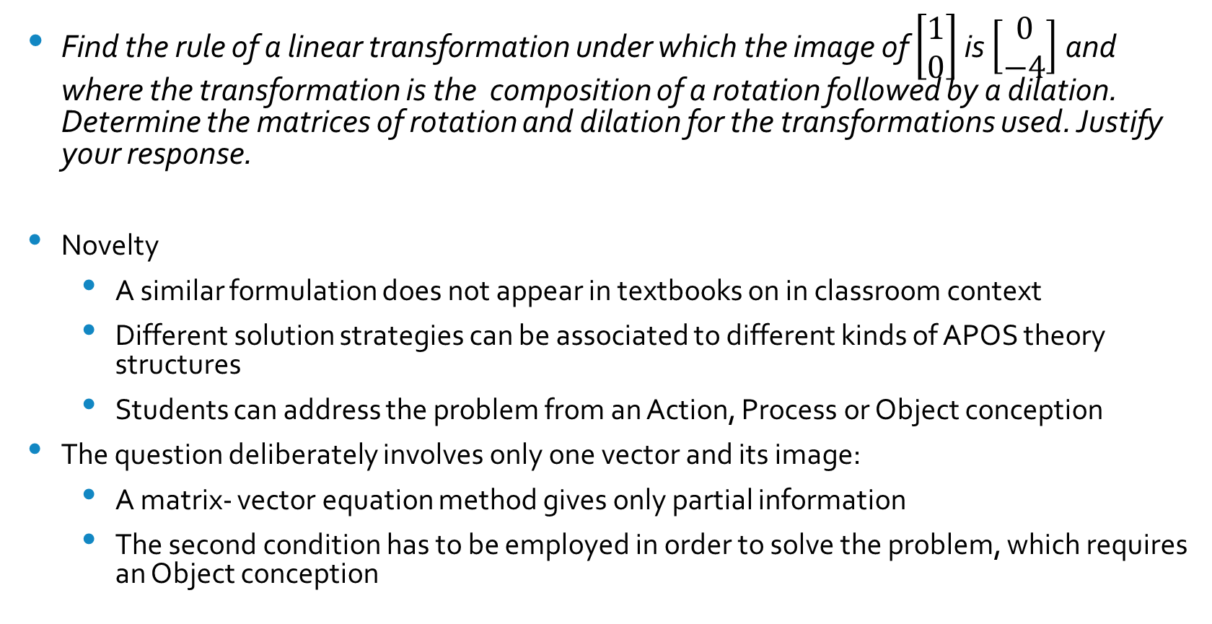
An example of good tasks in diagnosing students’ needs
Find the rule of a linear transformation under which the image of $\left[\begin{matrix}1 \\ 0\end{matrix}\right]$ is $\left[\begin{matrix}0 \\ −4\end{matrix}\right]$ and where the transformation is the composition of a rotation followed by a dilation. Determine the matrices of rotation and dilation for the transformations used. Justify your response.
Novelty
  A similar formulation does not appear in textbooks on in classroom context
  Different solution strategies can be associated to different kinds of APOS theory structures
  Students can address the problem from an Action, Process or Object conception
The question deliberately involves only one vector and its image:
  A matrix- vector equation method gives only partial information
  The second condition has to be employed in order to solve the problem, which requires an Object conception

Slide 12
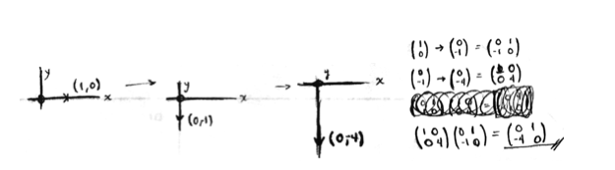
Analysis of student responses. An example
Use of Actions:
Most students in the three groups at different universities: 102 undergraduate students
APOS THEORY ANALYSIS
Recognition of the given vector as the image of the other
Geometric or algebraic ACTIONS to find a rotation matrix a dilation matrix or the resulting transformation
Focus on one vector, not on the domain of the transformation
The transformation (or matrix) did not satisfy the second condition of the problem

Slide 13
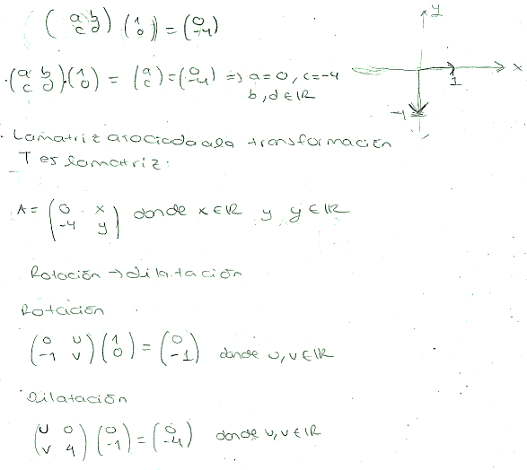
Students' responses: analysis - Process
Process conception: two students
APOS Theory analysis
Recognition of rotation and dilation matrices acting on every vector in the domain
BUT they applied them only to the given vector
They did not check the validity of the suggested transformation when applied to other vectors in the transformation domain

Slide 14
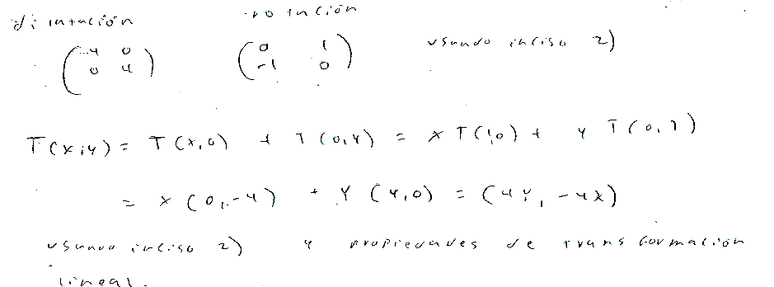
Students' responses: analysis - Object
Object conception: three students
APOS theory analysis
Similar procedure as the previous one
They operated on the first transformation by applying the second one to obtain a resulting general vector.
Then applied this transformation to the original vector to obtain its image
They could do Actions on a transformation: encapsulation into an Object

Slide 15
The goal of mentoring in teaching and learning
The overall experience goal:
Making graduate students aware of the complexity of “simple” linear algebra concepts
Underlining the possibilities offered by mathematics education research results
Discovering the advantages of collaborative work
Making instruction interesting through challenges that undergraduate students can use their way of thinking and develop new ways of thinking through opportunities to use proper ways of thinking (Harel DNR)
Addressing those challenges by introducing new concepts or theorems when students need them to continue their work

Slide 16
Learning to listen to students ideas and questions to address their needs
Develop strategies to be able to detect details in students’ questions and problem solving strategies that can elicit unexpected difficulties that need to be addressed for students to construct a deeper understanding of what is being taught
Create as many possibilities for students to develop mathematical reasoning and their ability to pose questions
Make argumentation a common practice in every lesson
Lectures can be used, but preferably when students have done some previous work that helps them understand them

Slide 17
        Thank you very much!

