Slide 1


Current Work in the
Inquiry-Oriented Linear Algebra (IOLA) Project
Dr. David Plaxco, Dr. Megan Wawro,
Dr. Christine Andrews-Larson, Dr. Michelle Zandieh
Huge thanks to NSF
DUE #1245673, 1245796, 1246083; DUE# 1915156, 1914841, 1914793
http://iola.math.vt.edu

Slide 2






IOLA: What is it?
The Inquiry-Oriented Linear Algebra (IOLA) project develops research-based student materials composed of challenging and coherent task sequences that facilitate an inquiry-oriented approach to the teaching and learning of linear algebra. The project also develops instructional support materials to help instructors implement the IOLA tasks in their classrooms.
Chris Rasmussen
San Diego State University
Michelle Zandieh
Arizona State University
Megan Wawro
Virginia Tech
Christine Andrews-Larson
Florida State University
David Plaxco
Clayton State University
NSF DUE #1245673, 1245796, 1246083; DUE- 1915156, 1914841, 1914793
http://iola.math.vt.edu

Slide 3
Characteristics of Inquiry-Oriented Instruction
We think about inquiry both in terms of what students do and what instructors do in relation to student activity (Rasmussen & Kwon, 2007)
The role of the teacher is to:
Facilitate student engagement in meaningful tasks and mathematical activity related to an important mathematical point
Elicit student reasoning and contributions
Actively inquire into student thinking
Be responsive to student contributions and use student contributions to inform the lesson
Engage students in one another's reasoning
Guide and manage the development of the mathematical agenda
Support formalization of student ideas and introduce language and notation when appropriate
Kuster, G., Johnson, E., Keene, K., & Andrews-Larson, C. (2018). Inquiry-oriented instruction: A conceptualization of the instructional principles. Primus, 28(1), 13-30.

Slide 4
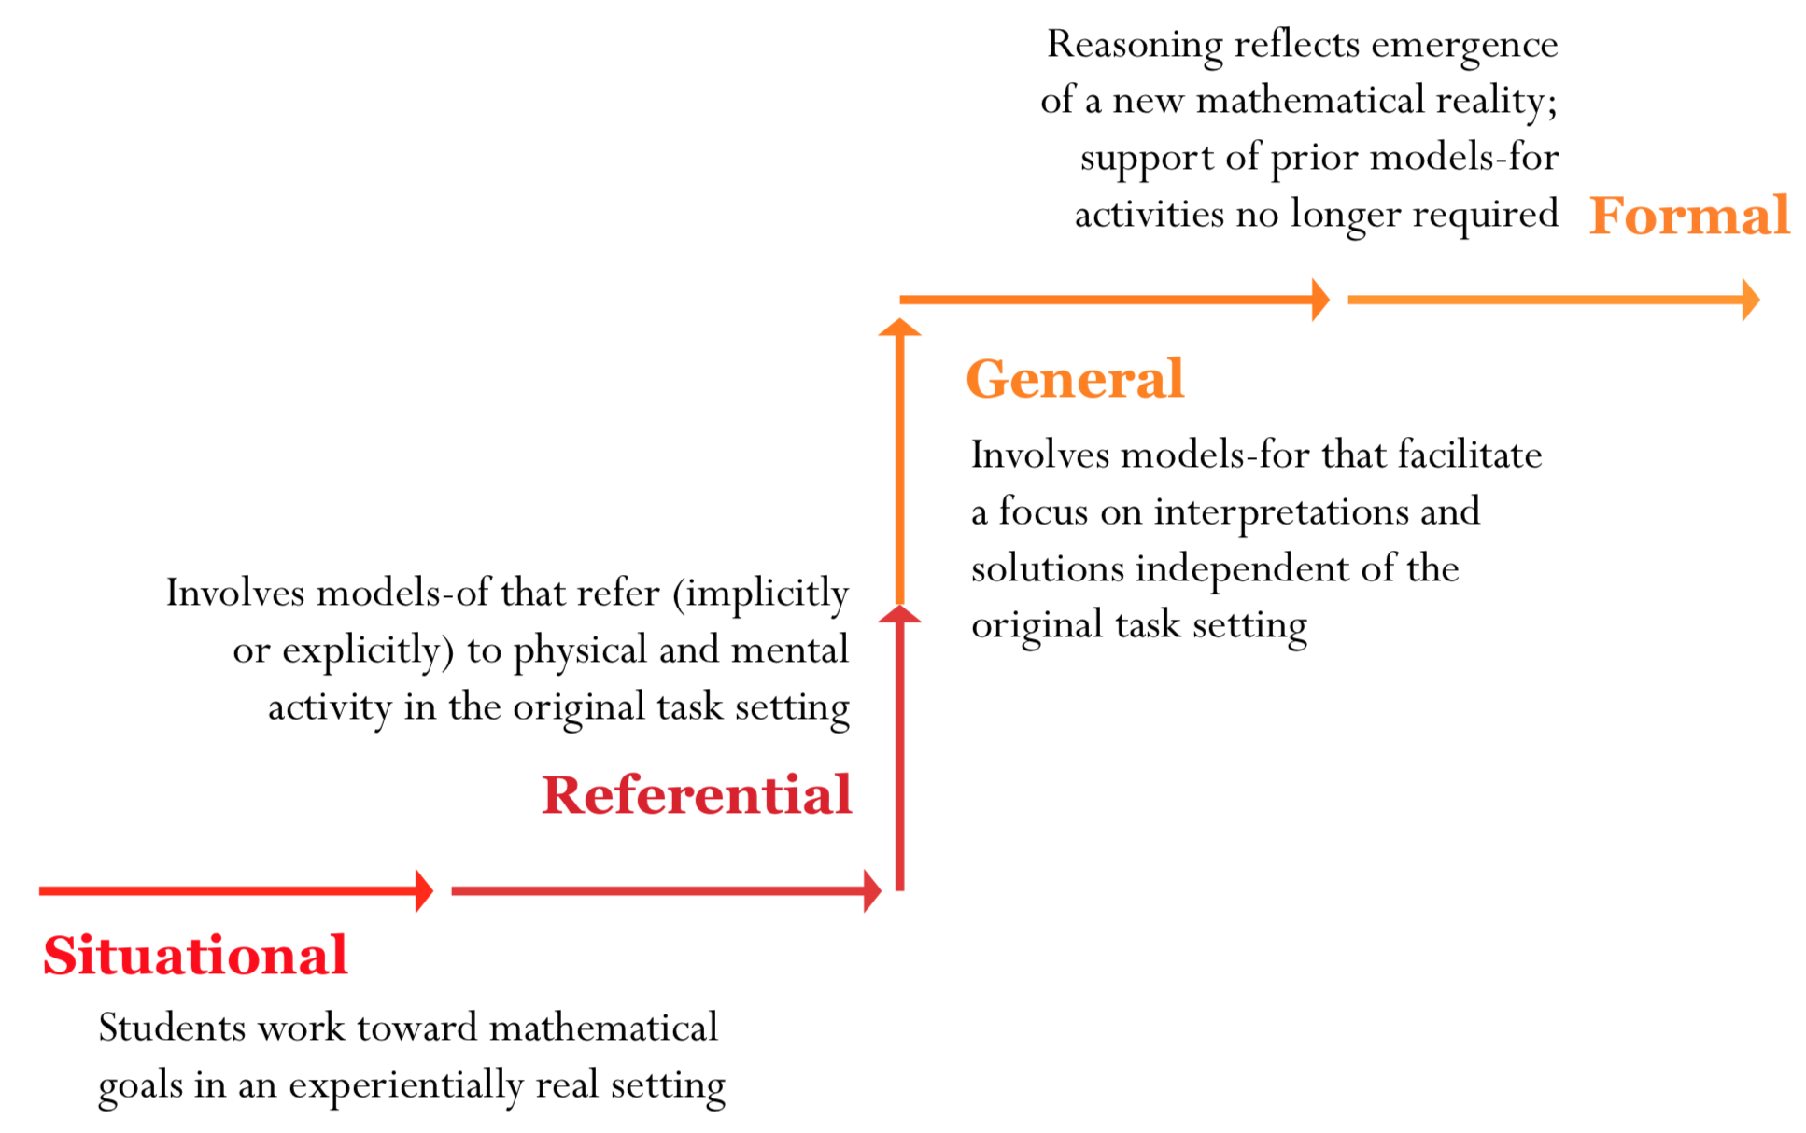
Realistic Mathematics Education
Instructional design theory originating in the Netherlands (Freudenthal, 1991; Gravemeijer, 1999) built on the tenet of mathematics as a human activity
Start with students’ current ways of reasoning to build toward more formal, sophisticated mathematics through guided reinvention
Notes:
Experientially real starting points are tasks that students can immediately engage in without formal instruction
Student activity, with instructor guidance, should evolve toward the reinvention of formal notions and ways of reasoning about the mathematics initially investigated
Classroom activity should support student development of models-of their mathematical activity that can be used as models-for subsequent mathematical activity

Slide 5
IOLA: What is it?
The Inquiry-Oriented Linear Algebra (IOLA) project develops research-based student materials composed of challenging and coherent task sequences that facilitate an inquiry-oriented approach to the teaching and learning of linear algebra. The project also develops instructional support materials to help instructors implement the IOLA tasks in their classrooms.
Unit 1: Linear independence and span
Unit 2: Solutions to systems of equations;
Unit 2: Matrices as linear transformations
Unit 4: The roles determinants in understanding linear transformations;
Unit 5: Vector space and subspace
Unit 3: Change of basis, diagonalization, and eigentheory
Unit 7: Projection, orthogonalization, and least squares
Unit 1: Linear independence and span (previously Unit 1);
Unit 2: Solutions to systems of equations;
Unit 3: Matrices as linear transformations (previously Unit 2);
Unit 4: The roles determinants in understanding linear transformations;
Unit 5: Subspaces
Unit 6: Change of basis, diagonalization, and eigentheory (previously Unit 3); and
Unit 7: Projection, orthogonalization, and least squares
Unit 1: Linear independence and span (previously Unit 1);
Unit 2: Solutions to systems of equations;
Unit 3: Matrices as linear transformations (previously Unit 2);
Unit 4: The roles determinants in understanding linear transformations;
Unit 5: Subspaces
Unit 6: Change of basis, diagonalization, and eigentheory (previously Unit 3); and
Unit 7: Projection, orthogonalization, and least squares
DIOIMLA – Original IOLA Grant
IOLA X
Chris Rasmussen
San Diego State University
Michelle Zandieh
Arizona State University
Megan Wawro
Virginia Tech
Christine Andrews-Larson
Florida State University
David Plaxco
Clayton State University
NSF DUE #1245673, 1245796, 1246083; DUE- 1915156, 1914841, 1914793
http://iola.math.vt.edu

Slide 6











IOLA-X Project Personnel
Isis Quinlan
Doctoral student
Virginia Tech
Gavin Sabine
Master’s student
Virginia Tech
Josh Doss
Undergraduate
Virginia Tech
Megan Wawro
Virginia Tech
Inyoung Lee
Doctoral student
Arizona State
Zac Bettersworth
Doctoral student
Arizona State
Michelle Zandieh
Arizona State University
Matt Mauntel
Doctoral student
Florida State
Jessica Smith
Doctoral student
Florida State
Christy Andrews-Larson
Florida State University
Minah Kim
Doctoral student
Florida State
Mark Watford
Doctoral student
Florida State
David Plaxco
Clayton State University

Slide 7

Iterative Design Process
CTE
Classroom Teaching Experiment
(Cobb, 2000)
OWG
Online Working Group
(Keene et al, in press)
Web
Develop Web-Based Instructor Guides
PTE
Paired Teaching Experiment
(Steffe & Thompson, 2000)
Design
Develop tasks based on
RME design heuristics
(e.g., Gravemeiejer, 1999; 2020b)
Revision Stages – Reflect, Analyze, and Revise

Slide 8
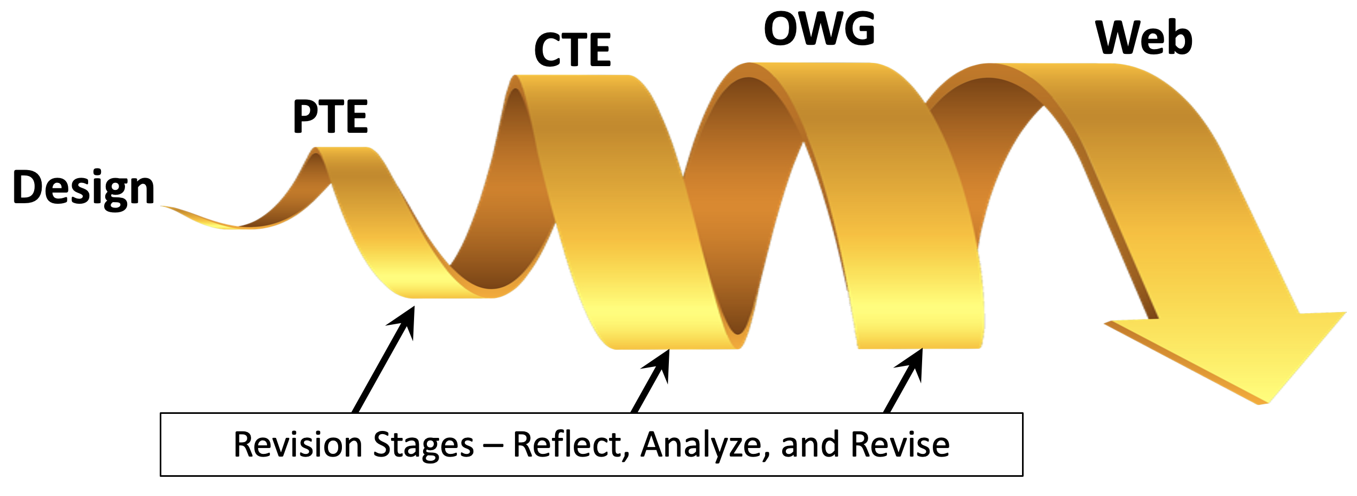
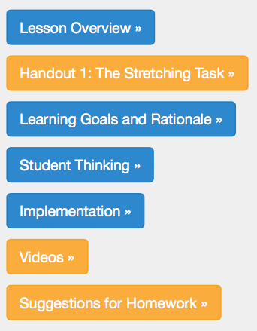
IOLA: Instructional Support Material
For each task, the instructor support materials include three main components:
Learning Goals and Rationale. Addresses how the task contributes to meeting instructional goals and what kinds of thinking are meant to be evoked, leveraged, or challenged
Student Thinking. Elaborates ways in which students might think about or approach the task, answers/strategies they will likely develop, and difficulties they are likely to have
Implementation. Includes suggestions for implementing the task, what kinds of debate topics might be most productive, and what types of student interaction teachers should anticipate
Also contains: task sheets for students, homework suggestions, and implementation video clips
http://iola.math.vt.edu

Slide 9
We asked ourselves:
What is POSSIBLE in terms of reinventing ideas about vector spaces or subspaces? Key points:
  Closure (of non-empty sets) under linear combinations
  Subspaces as sets that can be described as spans
What contexts can be helpfully solved using ideas about subspaces, null spaces, or column spaces?
  Networks in which flow is conserved have non-trivial null spaces (Boyd & Vandenberghe, 2018)
  Null spaces can also help characterize solution sets to non-homogeneous systems
Notes:
We first began considering the overall objectives of the unit on vector spaces as they related to the course as a whole. The conceptual core principle of focus, in our view, was the idea of vector spaces as spaces that are closed under linear combinations. (We did not aim to push students to reinvent the 9-10 vector space axioms.) We considered possible levels of generality (e.g. abstract vector spaces, finite and infinite dimensional vector spaces, vector spaces other than R^n, etc) and possible corresponding contexts (e.g. Bezier curves, mathematical settings focused on questions such as whether linear combinations of two continuous functions would be continuous, etc.). After some deliberation, consideration of experientially real starting points, and of emerging recommendations (e.g. forthcoming LACSG 2.0 recommendations) that a first course NOT focus on an abstract treatment of vector spaces, we decided to focus our work on the context of null spaces and column spaces

Slide 10
The subspaces* instructional unit:
*Beta version!
Common Prior Knowledge
Set notation (instructor can introduce in task 1 if needed)
Span, linear combinations of vectors (helpful for task 1)
Solving systems using substitution, elimination, and RREF (needed for Task 2)
Matrices as Linear Transformations (needed for Task 2)
Key Topics Addressed
Task 1: Closure (of “inputs”)
Task 2: Correspondence between (“input/output”) vectors
Task 3: Null spaces as type of closed “input” spaces and column spaces as type of closed “output” spaces
Notes:
Notes
Task 1 could be used to formalize subspaces without tasks 2 and 3 if null and column spaces aren’t critical. (It could also be a nice way too introduce set notation)
COULD use task 2 in the context of systems unit (e.g. as an application to link solutions of homogeneous and non-homogeneous systems)
Then return to task 3 after students have seen linear transformations…?

Slide 11
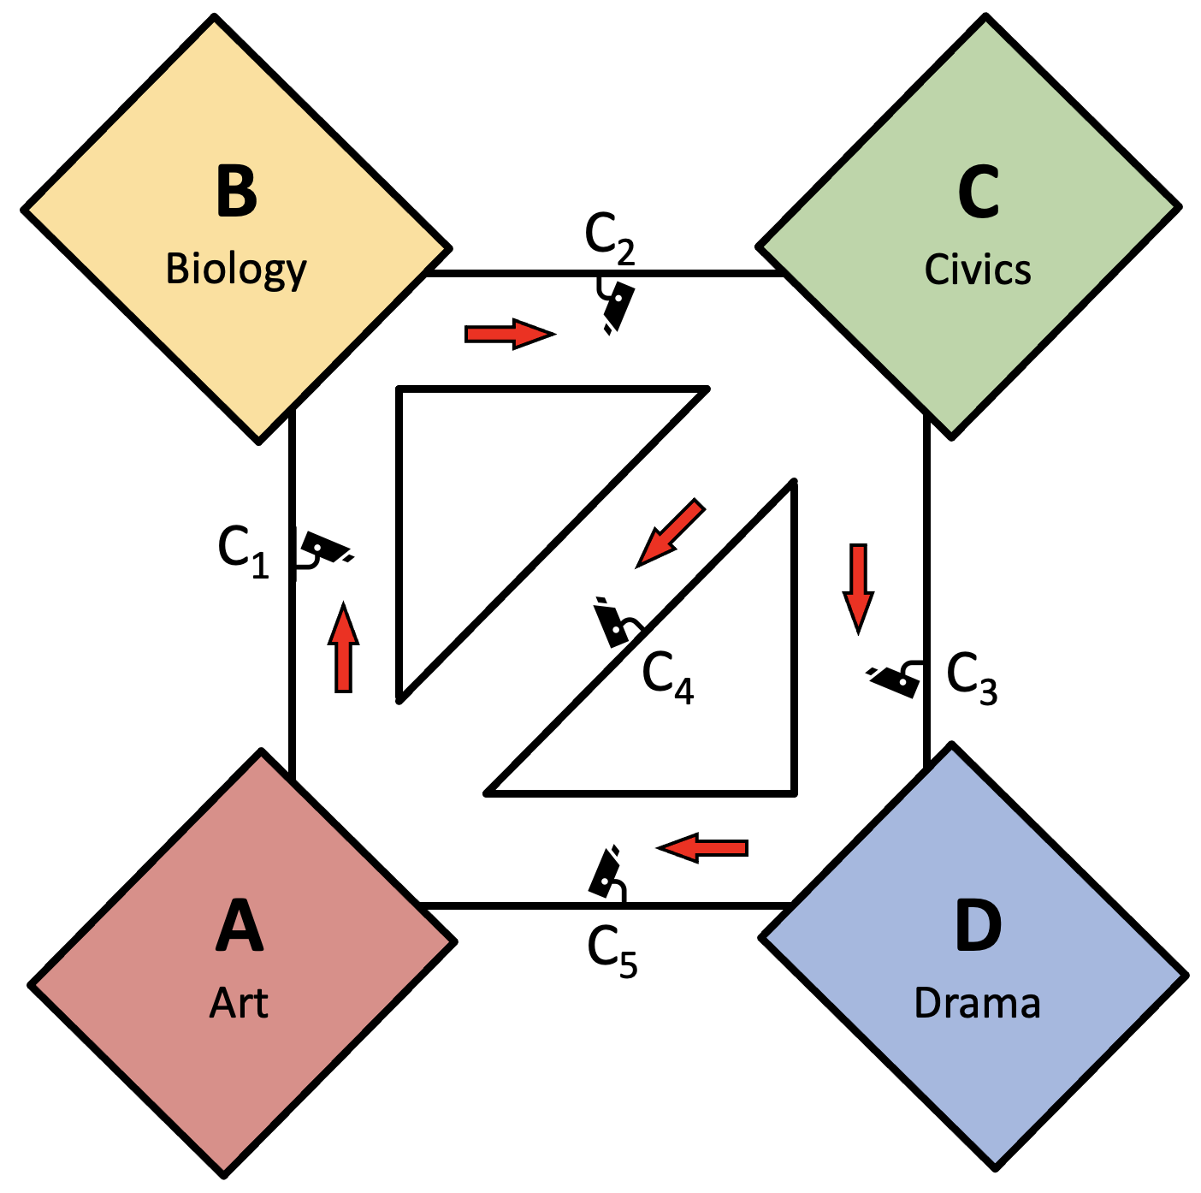
Problem Setting
The hallways in one wing of Ida B. Wells High School were changed to one-way corridors to promote social distancing during a pandemic (red arrows in the diagram). These hallways connect classrooms A-D (the Art room, Biology lab, Civics room, and Drama room) as shown in the diagram. Each hall has a security camera that allows Principal McDaniel to monitor student movement through the hallways (cameras 1-5, as shown in the diagram). As a further precaution, each wing is isolated from the rest, so the students in a wing stay within that wing and no students from any other part of the school will enter the west wing.
Notes:
BEFORE WE DIVE IN:
These tasks are substantial – we won’t do them full justice in the next 20-25 minutes.
The goal here is to give you some insight into the Learning Goals & Rationale, some student thinking, and a flavor of the implementation
WE HAVE COPIES FOR YOU!
Feel free to try them out, work through them, etc. and let me know if you have any questions.

Slide 12

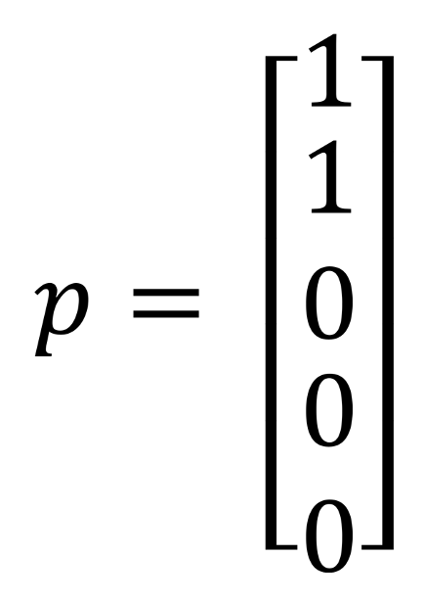
Scenario One: Creating a System to Help Organize and Track Movement
Before the school year starts, Principal McDaniel goes into the school when it is empty to spend a day learning how to use data from the camera system. Her daughter Ella comes with her, and she asks Ella to help her test the system by walking between rooms – so long as she stays in the building and follows the one-way hallway rules. Ella decides to start in the Art room, passes Camera 1 (C1) as she walks from the Art room toward the Biology lab, and then continues walking past Camera 2 (C2) as she walks from the Biology lab to the Civics room. Afterwards, Principal McDaniel sees that the camera system has recorded the number of people who walked by each camera with the vector:

Slide 13
Scenario One: Creating a System to Help Organize and Track Movement
Before the school year starts, Principal McDaniel goes into the school when it is empty to spend a day learning how to use data from the camera system. Her daughter Ella comes with her, and she asks Ella to help her test the system by walking between rooms – so long as she stays in the building and follows the one-way hallway rules. Ella decides to start in the Art room, passes Camera 1 (C1) as she walks from the Art room toward the Biology lab, and then continues walking past Camera 2 (C2) as she walks from the Biology lab to the Civics room. Afterwards, Principal McDaniel sees that the camera system has recorded the number of people who walked by each camera with the vector:

Slide 14
Scenario One: Creating a System to Help Organize and Track Movement

Slide 15
Task 1, Part 1 – Identifying Paths
Find a way to efficiently list ALL camera data vectors (or linear combinations of vectors) that could be shown after Ella walks from room A to C.
Find a way to efficiently list ALL camera data vectors (or linear combinations of vectors) that could be shown after Ella walks from room C to C.

Slide 16
Task 1, Part 2 – Considering Properties of Sets of Vectors
You have developed two sets of vectors (camera data vectors). Take a minute to describe each of the following sets of vectors. What similarities and differences do you notice between these sets?
S1: the set of paths of a single student from room A to C.
S2: the set of paths of a single student from room C to C.

Slide 17
Task 1, Part 2 – Defining Closure
New Definition: Closure of a Set under an Operation: A set of vectors S is called closed under vector addition if and only if, for any vectors v and u in S, v + u is also an element of S. A set of vectors S is called closed under scalar multiplication if and only if, for any vector v in S and scalar k, k*v is also an element of S.
Circle the choice that you think best describes the following sets:
  S1 is closed under: ONLY vector addition / ONLY scalar multiplication / BOTH / NEITHER
  S2 is closed under: ONLY vector addition / ONLY scalar multiplication / BOTH / NEITHER
Write at least two sentences explaining why you categorized the closure of each set in the way that you did.

Slide 18
Task 1, Part 3 - Consider These Scenarios (HW)
The next day, Principal McDaniel asks 5 of the school’s teachers to help her test the system a bit more. Principal McDaniel first asks all 5 of them to walk from Room A to C, stating each person can take any route they choose (e.g. all 5 teachers do NOT need to use the same route) so long as they stay inside the building and go the designated direction down each one-way hallway. Find a way to efficiently list ALL possible camera data vectors that may be shown after the 5 teachers have walked from Room A to C.
Find a way to efficiently list ALL possible camera data vectors that may be shown after the 5 teachers have walked from Room C to C.
You have developed two sets of vectors (camera data vectors). Take a minute to describe each of the following sets of vectors. What similarities and differences do you notice between these sets?
  S3: the set of paths of 5 people from room A to C.
  S4: the set of paths of 5 people from room C to C.
Circle the choice that you think best describes the following sets:
  S3 is closed under: ONLY vector addition / ONLY scalar multiplication / BOTH / NEITHER
  S4 is closed under: ONLY vector addition / ONLY scalar multiplication / BOTH / NEITHER
Write at least two sentences explaining why you categorized the closure of each set in the way that you did.

Slide 19
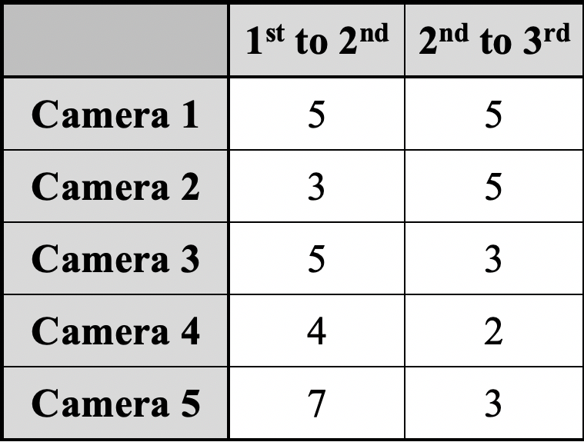
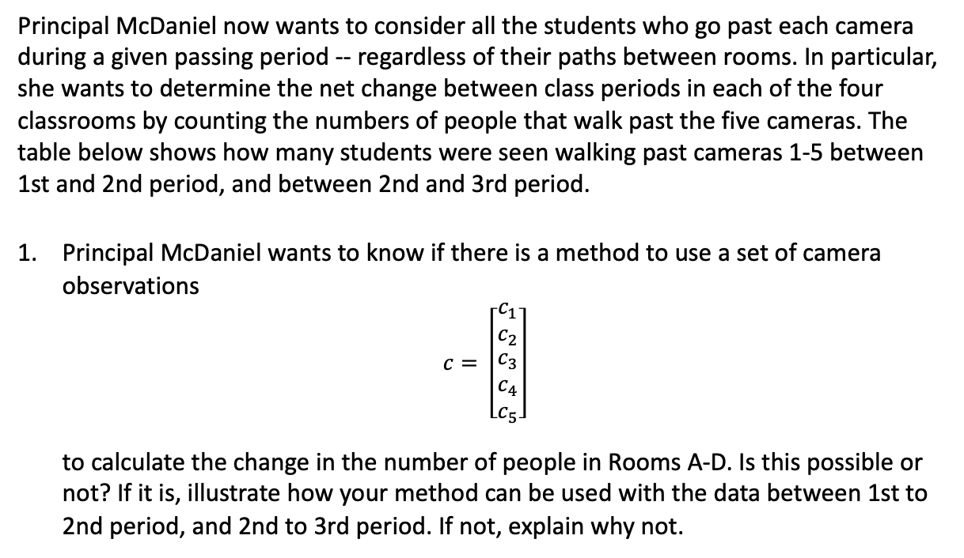
Task 2 - Linking Camera Data to Changes in Room Populations
Principal McDaniel now wants to consider all the students who go past each camera during a given passing period -- regardless of their paths between rooms. In particular, she wants to determine the net change between class periods in each of the four classrooms by counting the numbers of people that walk past the five cameras. The table below shows how many students were seen walking past cameras 1-5 between 1st and 2nd period, and between 2nd and 3rd period.
Principal McDaniel wants to know if there is a method to use a set of camera observations
$$c= \left[\begin{matrix}\begin{matrix}c_{1} \\ c_{2}\end{matrix} \\ \begin{matrix}c_{3} \\ c_{4} \\ c_{5}\end{matrix}\end{matrix}\right]$$
to calculate the change in the number of people in Rooms A-D. Is this possible or not? If it is, illustrate how your method can be used with the data between 1st to 2nd period, and 2nd to 3rd period. If not, explain why not.

Slide 20
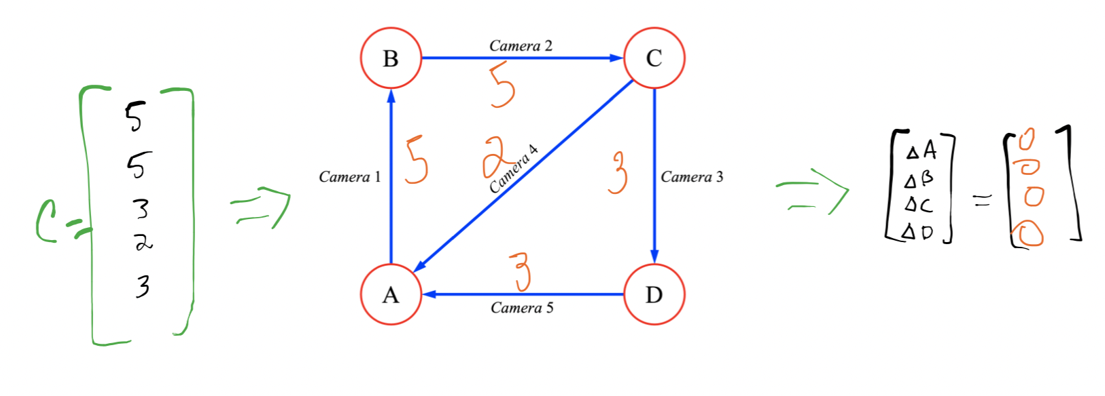
Task 2 - Linking Camera Data to Changes in Room Populations
Principal McDaniel now wants to consider all the students who go past each camera during a given passing period -- regardless of their paths between rooms. In particular, she wants to determine the net change between class periods in each of the four classrooms by counting the numbers of people that walk past the five cameras. The table below shows how many students were seen walking past cameras 1-5 between 1st and 2nd period, and between 2nd and 3rd period.
Principal McDaniel wants to know if there is a method to use a set of camera observations
$$c= \left[\begin{matrix}\begin{matrix}c_{1} \\ c_{2}\end{matrix} \\ \begin{matrix}c_{3} \\ c_{4} \\ c_{5}\end{matrix}\end{matrix}\right]$$
to calculate the change in the number of people in Rooms A-D. Is this possible or not? If it is, illustrate how your method can be used with the data between 1st to 2nd period, and 2nd to 3rd period. If not, explain why not.

Slide 21
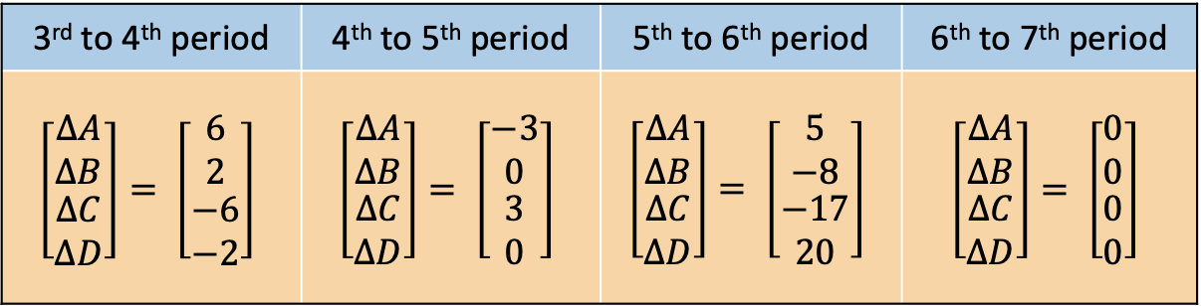
Task 2 - Linking Camera Data to Changes in Room Populations
The camera system went down for the remainder of the day, so there was no camera data – but the teachers in Rooms A-D reported for each period how many more or fewer students they had as compared to the previous period. This information is reported below. Determine the possible number of students who passed each camera during each of the passing periods.
3rd to 4th period | 4th to 5th period | 5th to 6th period | 6th to 7th period
$$\left[\begin{matrix}\begin{matrix}∆A \\ ∆B\end{matrix} \\ \begin{matrix}∆C \\ ∆D\end{matrix}\end{matrix}\right]= \left[\begin{matrix}\begin{matrix}6 \\ 2\end{matrix} \\ \begin{matrix}−6 \\ −2\end{matrix}\end{matrix}\right]$$ | $$\left[\begin{matrix}\begin{matrix}∆A \\ ∆B\end{matrix} \\ \begin{matrix}∆C \\ ∆D\end{matrix}\end{matrix}\right]= \left[\begin{matrix}\begin{matrix}−3 \\ 0\end{matrix} \\ \begin{matrix}3 \\ 0\end{matrix}\end{matrix}\right]$$ | $$\left[\begin{matrix}\begin{matrix}∆A \\ ∆B\end{matrix} \\ \begin{matrix}∆C \\ ∆D\end{matrix}\end{matrix}\right]= \left[\begin{matrix}\begin{matrix}5 \\ −8\end{matrix} \\ \begin{matrix}−17 \\ 20\end{matrix}\end{matrix}\right]$$ | $$\left[\begin{matrix}\begin{matrix}∆A \\ ∆B\end{matrix} \\ \begin{matrix}∆C \\ ∆D\end{matrix}\end{matrix}\right]= \left[\begin{matrix}\begin{matrix}0 \\ 0\end{matrix} \\ \begin{matrix}0 \\ 0\end{matrix}\end{matrix}\right]$$

Slide 22
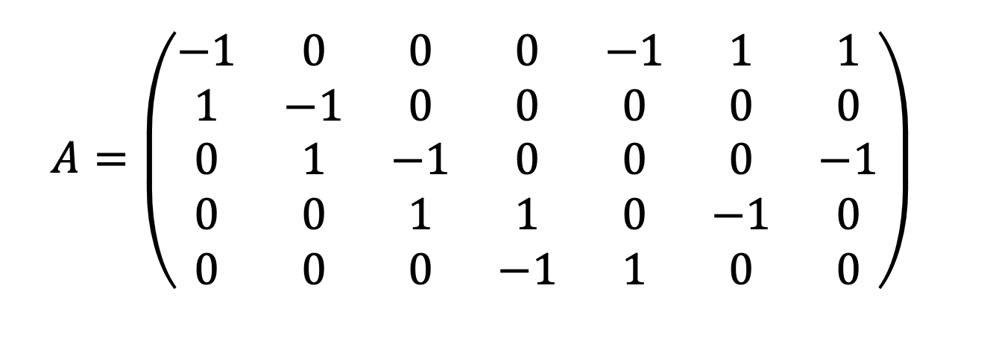
Task 3 - Monitoring Population Movement in the East Wing
The following matrix describes how to use the number of students seen passing through each of a set of one-way hallways in another wing of the school between a set of rooms. When the matrix is multiplied by the vector with the number of students observed by each camera, the result tells the change in the number of students in each room.
Part 1: Questions for whole group discussion:
List as many things as you know about the camera data vectors in this situation.
List as many things as you know about the population change vectors in this situation

Slide 23

Task 3 - Monitoring Population Movement in the East Wing
The following matrix describes how to use the number of students seen passing through each of a set of one-way hallways in another wing of the school between a set of rooms. When the matrix is multiplied by the vector with the number of students observed by each camera, the result tells the change in the number of students in each room.
Part 2: Questions for small group work
Describe the set U all the possible hallway flows that leave the number of students in each room unchanged.
Describe the set F of all the possible hallway flows that result in the following room changes:

Slide 24
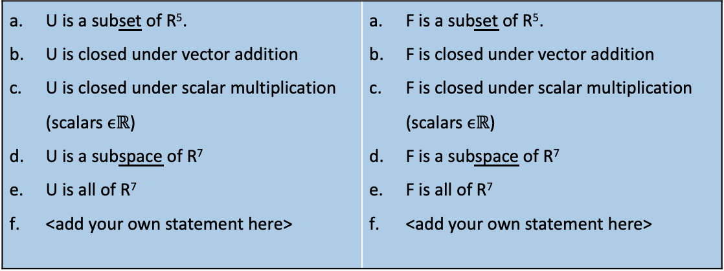
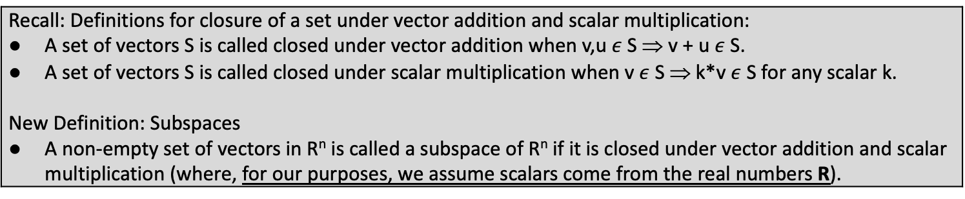
Task 3 - Monitoring Population Movement in the East Wing
Recall: Definitions for closure of a set under vector addition and scalar multiplication: A set of vectors S is called closed under vector addition when v,u $ε$ S ⇒ v + u $ε$ S. A set of vectors S is called closed under scalar multiplication when v $ε$ S ⇒ k*v $ε$ S for any scalar k. New Definition: Subspaces A non-empty set of vectors in R^{n} is called a subspace of R^{n} if it is closed under vector addition and scalar multiplication (where, for our purposes, we assume scalars come from the real numbers R).
U is a subset of R⁵. U is closed under vector addition U is closed under scalar multiplication (scalars $ϵℝ$) U is a subspace of R⁷ U is all of R⁷ <add your own statement here> | F is a subset of R⁵. F is closed under vector addition F is closed under scalar multiplication (scalars $ϵℝ$) F is a subspace of R⁷ F is all of R⁷ <add your own statement here>
Several statements are written about U and F below. Circle ones that are true and modify the ones that are false so that they become true statements. Describe the set P of all possible changes in the population of students in each room based on the information provided by matrix A.

Slide 25

Task 3 - Monitoring Population Movement in the East Wing
Recall: Definitions for closure of a set under vector addition and scalar multiplication: A set of vectors S is called closed under vector addition when v,u $ε$ S ⇒ v + u $ε$ S. A set of vectors S is called closed under scalar multiplication when v $ε$ S ⇒ k*v $ε$ S for any scalar k. New Definition: Subspaces A non-empty set of vectors in R^{n} is called a subspace of R^{n} if it is closed under vector addition and scalar multiplication (where, for our purposes, we assume scalars come from the real numbers R).
Describe the set P of all possible changes in the population of students in each room based on the information provided by matrix A.
Is the set P a subspace of R⁵? Why or why not? If not, how could the set be modified so it is a subspace of R⁵?

Slide 26
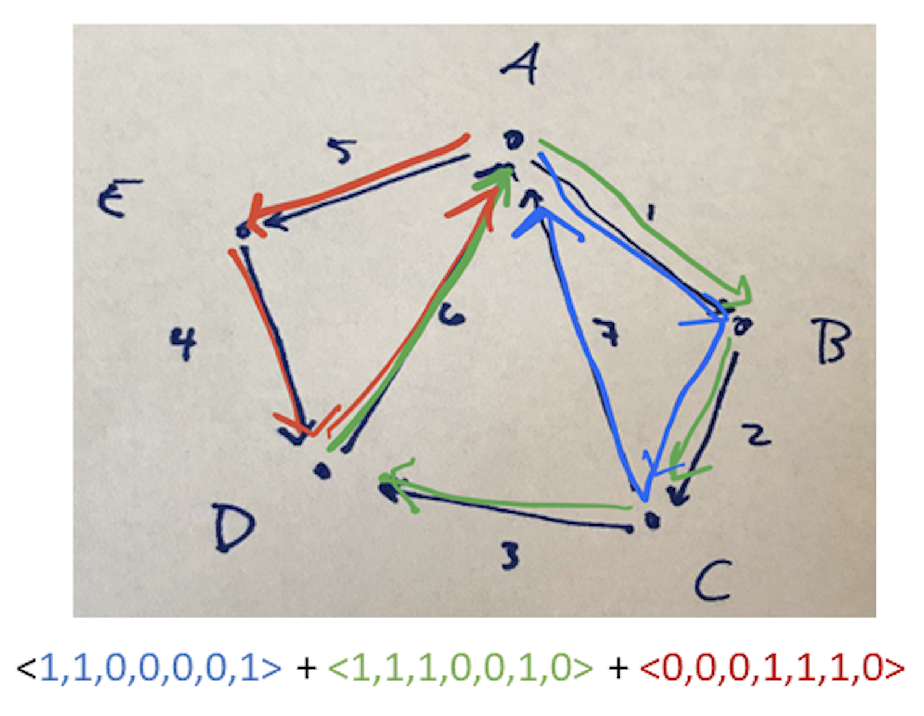
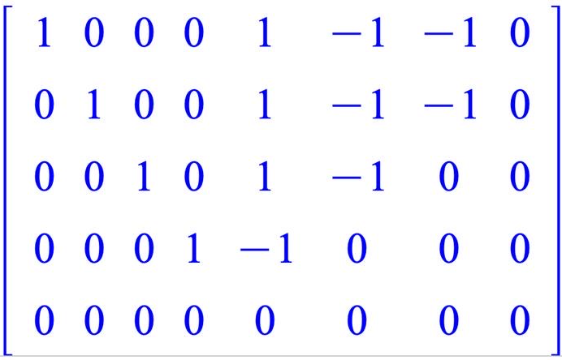
Task 3 - Monitoring Population Movement in the East Wing
Recall: Definitions for closure of a set under vector addition and scalar multiplication: A set of vectors S is called closed under vector addition when v,u $ε$ S ⇒ v + u $ε$ S. A set of vectors S is called closed under scalar multiplication when v $ε$ S ⇒ k*v $ε$ S for any scalar k. New Definition: Subspaces A non-empty set of vectors in R^{n} is called a subspace of R^{n} if it is closed under vector addition and scalar multiplication (where, for our purposes, we assume scalars come from the real numbers R).
Describe the set P of all possible changes in the population of students in each room based on the information provided by matrix A.
Is the set P a subspace of R⁵? Why or why not? If not, how could the set be modified so it is a subspace of R⁵?

Slide 27
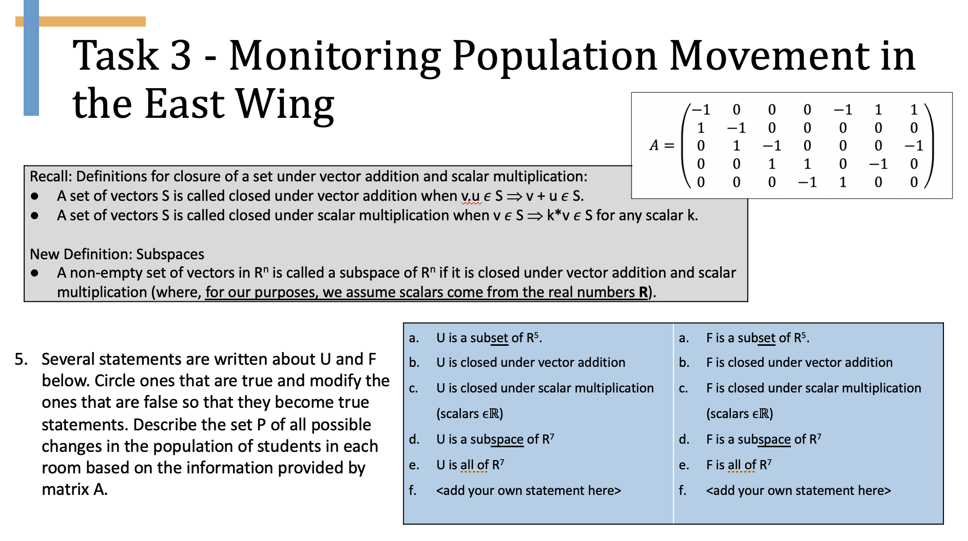
Realistic Mathematics Education
Instructional design theory originating in the Netherlands (Freudenthal, 1991; Gravemeijer, 1999) built on the tenet of mathematics as a human activity
Start with students’ current ways of reasoning to build toward more formal, sophisticated mathematics through guided reinvention
Notes:
Experientially real starting points are tasks that students can immediately engage in without formal instruction
Student activity, with instructor guidance, should evolve toward the reinvention of formal notions and ways of reasoning about the mathematics initially investigated
Classroom activity should support student development of models-of their mathematical activity that can be used as models-for subsequent mathematical activity

Slide 28
Takeaways
Tasks intended to support meaningful reasoning within a realistic problem context that can be leveraged toward more general and formal mathematics.
The core conceptualization retains value in a sense of reasoning about the more general mathematical concepts (i.e., adding or removing loops from a solution yields another solution)
Students engage in mathematical practices requiring them to transition between representational systems and contexts and identify structural analogues in each.
Please visit our website and create an account for free materials on existing units and to be notified when new units are uploaded to the website.
iola.math.vt.edu
Notes:
Experientially real starting points are tasks that students can immediately engage in without formal instruction
Student activity, with instructor guidance, should evolve toward the reinvention of formal notions and ways of reasoning about the mathematics initially investigated
Classroom activity should support student development of models-of their mathematical activity that can be used as models-for subsequent mathematical activity

Slide 29



Thank you!
dplaxco@clayton.edu
mwawro@vt.edu
iola.math.vt.edu
Questions?
McAfee Knob, Appalachian Trail, 45 min from Blacksburg. Photo Credit

Slide 30
Idea for Instruction, no matter the content
Give students space to explore and pursue a problem-solving approach that is sensible to them
Encourage/motivate students engage in each other’s ideas and collaborate
Make listening to and learning from multiple students explaining their approaches a normal part of class
Asking small groups to collectively say one thing they are confident about and one thing they are still confused or curious about can encourage openness, curiosity, as well as honor their current knowledge
One Discussion Board / Blog idea I used this semester in online course (credit: Christy Andrews-Larson)
  Prompt them to summarize their thinking on a task from class (e.g., one generalization about linear independence)
  Have them share one concept they feel confident they “know”
  Have them share one thing about which they “wonder”
  Have them give one “shout out” to someone who influenced their thinking

Slide 31
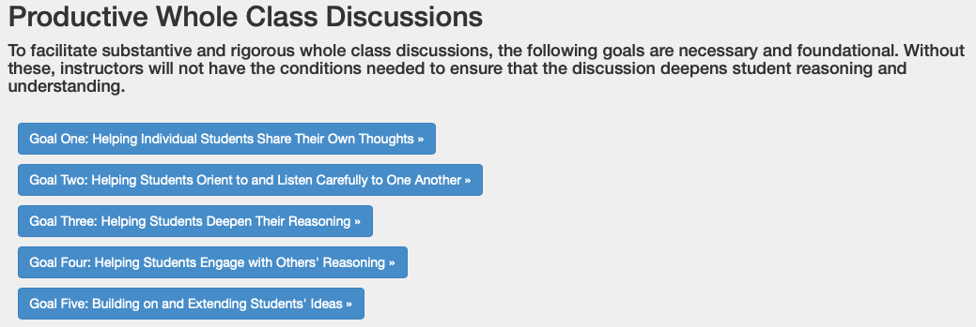
Idea for Instruction, no matter the content
Facilitating a mathematical conversation among the students can be hard and feel unnatural at first
We have suggestions for a Productive Whole Class Discussion on the IOLA website (lead: Chris Rasmussen)
http://iola.math.vt.edu/typicalday.php

Slide 32
Idea for Instruction, no matter the content
We have found trying to develop an intellectual need for new concepts or procedural skills to be very helpful for students in following and appreciating the connection of concepts within the course
The RME idea of guided reinvention can be an informal, accessible introduction to an idea that later becomes formalized (e.g., ”everywhere you can get” is the idea of span) or a mathematical activity such as conjecturing and proving (e.g., students suggest that sets with the zero vector are LD)
Thinking about the teacher as a broker (Lave & Wenger, 1991) between the classroom community and the mathematics community can help imagine your role as fostering students’ mathematical work and then aligning that with formal conventional terms and symbols from the mathematics community (Zandieh, Wawro, & Rasmussen, 2017)

Slide 33
Putting our instructor hat back on
Where is this going?
  Task 1 introduces ideas about closure under linear combinations (and set notation if students haven’t seen it), which is at the heart of subspaces.
  Task 2 pushes students to establish correspondence between vectors (e.g. inputs and outputs of a matrix transformation)
  Task 3 pushes students to consider closure of sets of inputs and outputs under linear combinations (e.g. null spaces and column spaces as subspaces)

Slide 34
Reflecting on pedagogy & equity
Content issues: What aspects of this learning approach do you see as most promising for supporting students’ learning? What do you feel less sure about?
Affective issues: What aspects of this experience did you find affirming or engaging? What aspects of this experience did you find uncomfortable?
Equity issues: How might students from various groups experience this similarly or differently than you did?
Notes:
WILL NEED TO REVISIT THESE IN SESSION TWO.

